Slide 1
Documentum Architecture
Notes:
Place the audio notes for this slide here

Slide 2

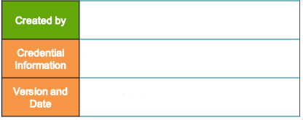
Enterprise Content Management Compétency
V 0.2, 13th February 2018

Slide 3
Agenda
Documentum Platform Architecture
Client-Server Communication
WDK
Web Application Communications
Useful Queries

Slide 4
Documentum Platform Architecture

Slide 5
Architecture
This chapter provides information on :
Platform Based Architecture
Content Application Layer
Interface Layer
Content Service Layer
Content Repository Layer

Slide 6
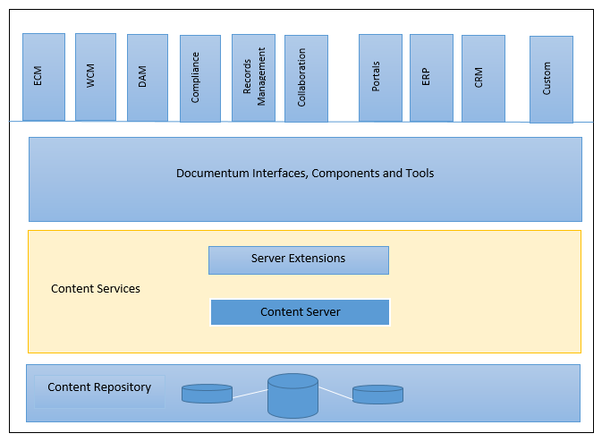
Architecture – Platform Based Architecture
Four Layers of the Documentum ECM Platform
Content Application Layer Consists of Documentum products, integrated applications, custom client applications that communicate with the Content Server.
Interface Layer Provides communication interface between the services layer and clients.
Content Services Layer Consists of the Documentum Content Server and a variety of extended services that provide content management functionality.
Content Repository Layer Consists of the file storage system and database that makes up the Documentum repository. The lower three layers of architecture comprise the Documentum platform.
Notes:
Acronyms
ECM = Enterprise Content Management
WCM = Web Content Management
DAM = Digital Asset Management
ERP = Enterprise Resource Planning
CRM = Customer Relationship Management

Slide 7
Architecture
iHub
Application Layer
Web-based applications
Portal Applications
Enterprise Applications
App Works
DFS
DFC
D2FS
BOF
WDK
Blazon
Development Layer
Brava
Integration Layer
Content Services Layer
Core Services
Extended Services
Courier
Office 365
Repository Layer
Database
File System
Full-Text Index
Distributed Repository
Other Repositories and Storage
OTDS
GDPR

Slide 8
Content Services Layer
Content Server Services
Core Services
Extended Services
RPS: Policies to automate retention and disposal of content.
TCS: application-specific security requirements through file store encryption.
Repository Services (RPS, TCS)
Library Services
These services consist of a framework of adapters for various internal and external repositories and enable searching multiple heterogeneous repositories together.
Enterprise Content Integration
Security Services
services to convert various kinds of content from one format and resolution into others.
Content Transformation Services
Process Management Services
services to analyze the text within documents and other content objects and automatically set their metadata.
They can also categorize these documents according to predefined rules.
Content Intelligence Services
XML Services
These services deliver and deploy content to web servers, portals, and application servers. It includes:
Site Caching Services
Site Deployment Services
Site Delivery Services
These services use specialized collaborative objects to enable multiple users to work on common documents in the repository together, which include rooms, discussion threads, contextual folders, and notes.
Collaboration Services

Slide 9
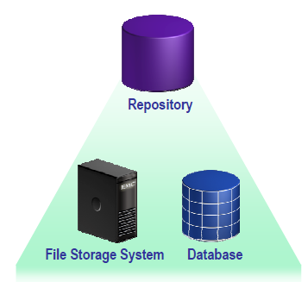
Content Repository Layer
The Documentum Repository
Stores content on a file storage system
Stores properties/metadata in a Relational Database Management System (RDBMS)
Example Oracle, SQL Server, DB2, Posgre SQL
Supports multiple Operating Systems
Example Unix, Linux, Windows
Supports Containerization
Example Docker

Slide 10
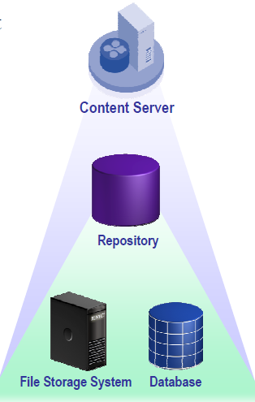
Services Layer : Content Server
The Content Server is a service that manages the repository
The repository can only be accessed via the Content Server service
Supports client-server and web-based applications
Content Management services provided by the ECM platform
Common to all content types
Available to all applications
Specific services can be added based on business needs
Documentum’s platform architecture allows these services available to all clients.
Notes:
Does the Content Server allow access to content on the file system?
The files are stored in a protected directory structure. By default, only Documentum installation owner account can directly access the files on the file system.
Does the RDBMS server have to be on the same machine?
No. When RDBMS is on separate machine, Documentum uses appropriate networking software such as SQL*Net for Oracle

Slide 11
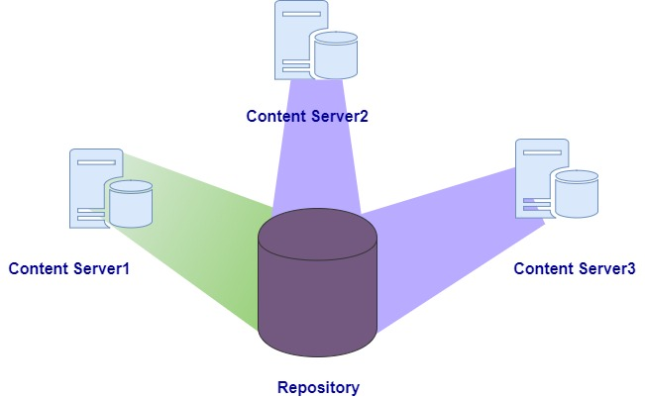
Services Layer: Repository Management
One Content Server usually manages a single repository.
For load balancing, more than one content server may access a single repository.
Notes:
Can a content server serves multiple repositories?
Yes, We can have more than a repository in a content server. But only one global repository is allowed.

Slide 12
Services Layer: Platform Extensions
Documentum extended services products extend the capabilities of the Content Server beyond core content management services and can extend any aspect of the content management framework, The below are examples
Media Services
Provides value-added management capabilities for specific rich media formats such as images, audio, video and complex data formats of specialized applications including Quark, QuarkXpress, Adobe InDesign and Microsoft PowerPoint.
Content Intelligence Services (CIS)
CIS uses an independent server to analyze documents in the repository and extract a list of properties that describes each document. CIS performs a semantic analysis that determines what each document is about, using customized taxonomy that lists the concepts to look for and identifies the evidence for the concepts

Slide 13
Services Layer: Platform Extensions - Contd
Trusted Content Services (TCS)
Provides additional security features including encrypted communications, encrypted file stores, electronic signatures, and enhanced object permissions.
Documentum Collaborative Edition (DCE)
Provides collaborative capabilities for OpenText Documentum applications, allowing teams to work securely and collaboratively within the context of content-centric web applications. DCE is a universal client extension that transforms any Web Development Kit (WDK)- based client into a collaborative environment that fosters teamwork within the context of a business process.

Slide 14
Interface Layer: Components and Tools
Clients and applications use the interface layer to communicate with the Content Server
Documentum Foundation Services (DFS)
DFS is an Service Oriented Architecture (SOA) development framework and Web Services API.
Documentum Foundation Classes (DFC)
DFC provides an API layer that exposes Documentum functionality.
Business Object Framework (BOF)
BOF allows developers to extend DFC by providing a framework and methodology to develop reusable business logic components called Business Objects. Business Objects can then be plugged into middle-tier or client applications. There are two types of Documentum Business Objects:
Type-Based: Can extend a Content Server persistent object type and extend its capabilities by providing new methods for those types and allow overriding of existing methods. Enables developers to define type-specific behavior without the need to customize each client.
Service-Based: Provides methods that perform more generalized procedures that are not usually bound to a specific object type of repository.

Slide 15
Interface Layer: Components and Tools -Contd
Web Development Kit (WDK)
WDK provides a framework on which to build Web Applications that connect to the Content Server.
D2 Foundation Services (D2FS)
D2FS provides an API layer that exposes Documentum Functionality in D2 application.
Web Services
Custom business logic can be exposed a Web Services, providing a way to call functions on other computers across an intranet or the internet. For example, a CRM system can communicate with Documentum through Web Services.

Slide 16
Client Application Layer – Documentum Clients
Documentum Clients
Web-Based Applications
For web-based applications, content server sees the application server as the client.
Documentum Client for Outlook
Organizes e-mail and documents within a single folder structure for easier navigation and management.
Records Manager
Manages the retention and disposition of corporate records, both physical and electronically.
Webtop
Core content management functionality from a web browser
Digital Asset Manager (DAM)
Provides features to manage rich media content

Slide 17
Client Application Layer – Documentum Clients - Contd
Documentum D2
Advanced, intuitive, and configurable content-centric client for Documentum that accelerates adoption of OpenText applications.
Documentum xCP
A flexible development platform for automating complex, information-intensive processes to drive better business decisions.
APxCelarator Mobile
A mobile application to access the tasks, review, approve or reject invoices on the go with mobile.
D2 Mobile
Application allows to access to all the D2 content with advanced search capabilities from mobile.
Core
Helps in sharing and accessing Documentum content anytime, anywhere with anyone safely and robustly through mobile using Android and iOS.

Slide 18
Client Application Layer – Enterprise Application Integration
Content Integration Services
Documentum offers several products that enable interaction with the Documentum ECM system from within other enterprise applications. The integration links content in Documentum repositories with objects in the enterprise application, providing users with access to key Documentum functionality using the familiar interface of the enterprise application.
Business Process Services
Integrates Documentum process, content and repository services with external systems though service- orient architecture. This allows enterprise applications and integration frameworks, message brokers, external applications and services, and individual users to take advantage of all Documentum capabilities and events.
Proprietary Applications
Applications not encompassed by dedicated integrations can still use the DFC and WDK to interact with the content server.

Slide 19
Integration Layer
Blazon
Render additional content types with expanded transformation services. This comes as an additional plug-in and is of free of cost along with Content Transformation Services (CTS). CAD and ICH renditions are possible with Blazon with least disruptions.
Brava
Brava provides access to content in virtually any format – like PDFs, images, etc. The light weight plug-in can incorporate with Documentum xCP to view the PDF, TIFF, JPG, PNG, BMP and GIF formats with out rendtions.This supports adding annotations, search text, high resolution viewing, page operations, selection and coping of text.
Courier
Extends case management content flows to external contributors with automated workflow. This is integrated with xCP designer and helps in exchange of documents and define upload/download of customer document and exchange of comments with customer from within xCP
GDPR
File Intelligence, which helps in protecting private data, prompts for actions based on type and identifies content anywhere on network and deploys quickly, delivering rapid time to value.

Slide 20
Test Your Understanding
Can a content server serves multiple repositories?
Yes
No
Ans: a

Slide 21
Test Your Understanding
What are the Documentum applications
webtop
Salesforce
Da
Documentum Desktop
D2
Ans: a,c,d,e

Slide 22
Client-Server Communications

Slide 23
Content Concepts
This chapter provides information on :
Connection Broker
Documentum Foundation Classes (DFC)
Documentum Foundation Services (DFS)

Slide 24
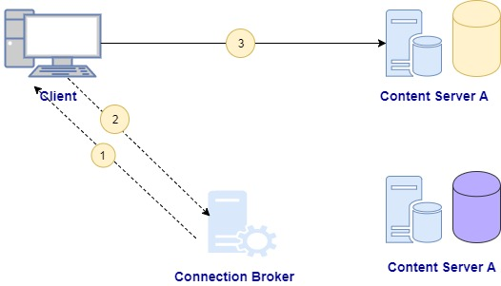
The Connection Broker
.

Slide 25
The Connection Broker - Contd
Connection Broker:
The connection Broker is a process on the server that provides connection information to client sessions
Determines which content connects to a Content Server.
Maintains list of available Content Servers and repositories
Eliminates the need for Content Server names on every client
Enabling a connection
The client connects to the connection broker and requests connection information for all currently available repositories
The connection broker downloads this information to the client which is then stored in memory on the client
The client uses this information to find the requested Content server and to connect to the requested repository.

Slide 26
The Connection Broker - Contd
Content Server information in Connection Broker
The connection broker stores the content server information includes
Server name
Server process ID
Name of host machine
Server status
Date end time is when connection broker last received information from the content server.
When the connection broker expects to hear from the content server
Repository Name
Repository Id

Slide 27
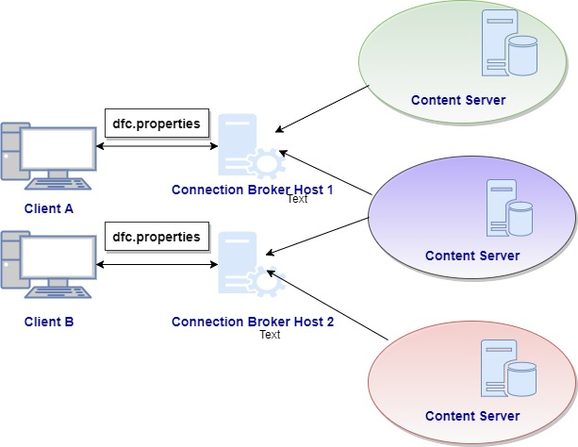
The Connection Broker – Multiple Content Servers
Connection Broker can hold information about multiple content servers.
Content servers can register with multiple connection brokers
Each client specifies a connection broker information in dfc.properties
An application server considered as a client.

Slide 28
The Connection Broker – dfc.properties
dfc.properties
The property file in the client/application system
Holds the connection broker information and other repository related information.
Can hold multiple connection broker information to connect to different repositories on selection.
dfc.docbroker.host[0] holds the docbroker information.
dfc.docbroker.port[0] holds the docbroker port information.
The below file shows the full properties which can be configured in dfc.properties

Slide 29


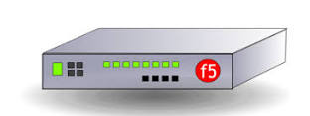

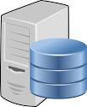

The Connection Broker – High Availability Environment
Distributed Messaging Server (DMS)
Users
BOCS Server (Remote Locations)
Distributed Messaging Server (DMS)
Load Balancer
Transformation Server (ADTS)
Transformation Server (ADTS)
Application Server 1 (D2LS-R&D)
Application Server 2 (D2LS-R&D)
FT Index Server (xPlore)
FT Index Server (xPlore)
Content Server 1
Content Server 2
FT Index (SAN)
FT Index (SAN)
RDBMS
Content File Storage NAS

Slide 30
Documentum Foundation Classes (DFC)
DFC
The DFC provides an object-oriented framework for accessing the capabilities of the Content Server
This implemented as a set of java classes and interfaces along with a Java-COM bridge for accessing DFC via COM from Visual Basic or Visual C++
Every computer running a client application has a copy of the DFC running on a Java Virtual Machine (JVM)
A copy of the DFC is also installed on the Content Server for server-side method calls.
Prior version of the DFC provided a Primary Interop Assembly (PIA) that supports Microsoft.NET programming languages.
Can be used by applications developed in Visual Basic, C#, C++ and other development environments.

Slide 31
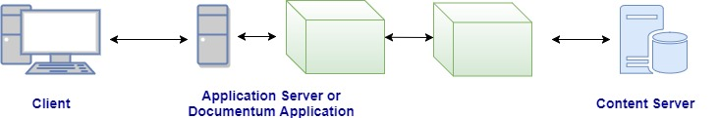
Documentum Foundation Classes (DFC) - Contd
= DMC EMULATOR

Slide 32
Documentum Foundation Services (DFS)
DFS
The DFS is a set of tools and services used to build service oriented applications utilizing OpenText Documentum functionality
Call core Documentum services
Call ObjectService.create() to create folder in the repository
Create new services
Extend existing DFS functionality to include integration with custom applications (CRM, Finance, etc)
Combine and orchestrate services
Use a common code base to support multiple business processes.
DFS runs in the Java Virtual Machine (JVM) in the method server

Slide 33
DFC and DFS
Using DFC
Creating client-server applications that are not service-based.
Creating services (except composite services)
Creating service based business objects (SBOs)
Implementing lower-level customizations not possible with DFS.
Using DFS
Adding OpenText Documentum functionality to a service oriented architecture
Using Microsoft.NET or other non-java based technologies

Slide 34
Client-Server Application Communication
Client – Server Application communication
The content server projects to the connection broker
The client connects to the connection broker to retrieve connection information for the content server
The client establishes a connection and issues API commands to the content server via the DFC/DFS
The content server processes the client APIs and retrieves the requested information from the repository.
The content server sends the information back to the client using APIs via the DFC/DFS
The client application refers to the any program used by end-user that communicates directly with the content server.

Slide 35
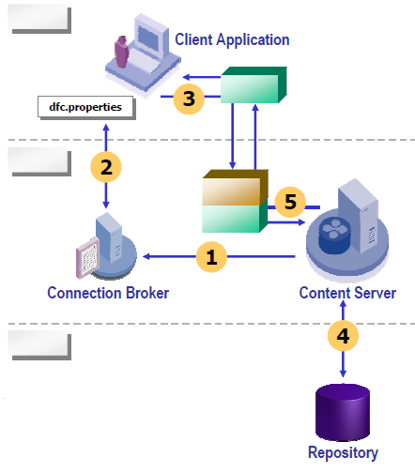
Client-Server Application Communication - Contd

Slide 36
Test Your Understanding
Which programming interface is used by client applications to communicate with the content server
WDK
DFC
dmcl.ini
Connection broker
Ans: b

Slide 37
Test Your Understanding
For web applications, the browser is the actual client to the content server
True
False
Ans: False, The content server treats the
application server as the client.

Slide 38
WDK

Slide 39
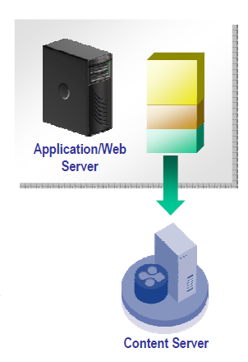
Web Development Kit (WDK)
WDK
The Documentum Web Development Kit (WDK) provides a framework on which to build web applications that connect to the content server
Webtop
Documentum Administror
Web Publisher
WDK applications reside on a J2EE-compliant application server
Communicates with the content server via DFC
Users access WDK applications through a web browser

Slide 40
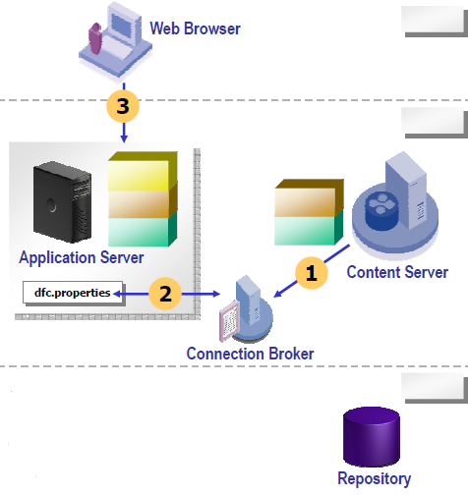
Web Application Communication
The Content server registers itself with the connection broker
The application server connects to the connection brokers to retrieve connection information for the content server
The client issues a URL to the application server
The application server resolves the request to the correct JSP page
The JSP engine dynamically creates a servlet from the JSP page
It follows the tired architecture
First Tier: Client Interface
Second Tier : Business Logic
Third Tier : Data Storage

Slide 41
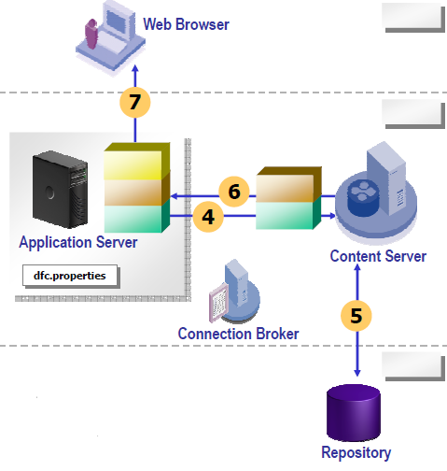
Web Application Communication - Contd
The servlet uses WDK methods that call DFC classes, DFS services, or Business objects that issue API commands to the content server
The content server processes the APIs and retrieves the requested information from the repository.
The content server sends the information back to the servlet
The servlet sends the content to the browser

Slide 42
Useful Queries

Slide 43
Useful Queries
How many concurrent connections are allowed by the content server
Select concurrent_sessions from dm_server_config
What is the default location for server log files
Select log_location from dm_server_config
List the machine name where connection brokers reside
Select projection_targets from dm_server_config
What is the login ticket/session time out
Select login_ticket_timeout from dm_server_config
What is the oldest client version from which the repository will accept a connection (0=any version)
Select check_client_version from dm_docbase_config

